Slide 1
CDS Hooks for decision support on
potential drug-drug interactions
CDS Workgroup
HL7 Connectathon – May, 18th 2021

Slide 2
Disclosures
Neither myself or my spouse have any relevant financial relationships with commercial interests

Slide 3
Primary take home message
CDS Hooks enables meaningful drug-drug interaction clinical decision support

Slide 4
Outline
The use case - contextualized drug-drug interaction clinical decision support
The role of CDS Hooks
Discussion

Slide 5
Outline
The use case - contextualized drug-drug interaction clinical decision support

Slide 6
Potential drug-drug interactions (PDDIs)
Exposure two or more drugs that are known to interact
“potential” because exposure does not necessarily mean a clinically meaningful effect

Slide 7
Clues about the frequency of harm
Clinically important events attributable to drug-drug interactions [1]:
5.3% - 14.3% of inpatients
231,000 US emergency department visits
Hospital admissions associated with an adverse drug event attributable to drug-drug interactions [2]:
22.2% (interquartile range 16.6 - 36.0%)
Magro L, Moretti U, Leone R. Epidemiology and characteristics of adverse drug reactions caused by drug-drug interactions. Expert Opin Drug Saf. 2012;11(1):83-94. doi:10.1517/14740338.2012.631910
Dechanont S, Maphanta S, Butthum B, Kongkaew C. Hospital admissions/visits associated with drug-drug interactions: a systematic review and meta-analysis. Pharmacoepidemiol Drug Saf. 2014;23(5):489-497. doi:10.1002/pds.3592.

Slide 8
“When the Holes Line Up”
A + B
Prescriber’s Knowledge
Computer Screening
Pharmacist’s Knowledge
Patient Risk Factors
Drug Administration
Patient Education
Monitoring
Defenses
ADR
Latent Failures
Hansten PD, Horn JR. Modified from: James Reason, Human Error, 1990

Slide 9
Prescribers PDDI knowledge
Prescriber knowledge is often lacking
12,500 United States prescribers correctly identified 42.7% of 14 drug pairs¹
281 Iranian medical residents correctly classified only 41% (5.7/14) of 14 drug pairs²
Mean number of correct responses from 244 Turkish physicians regarding the clin­ical significance of the 7 COVID-19 therapy related DDIs was 2.04 (±1.31)³
[1] Ko et al. Drug Saf. 2008;31(6):525-536
[2] Nabovati et al. International journal of clinical pharmacy 39.3 (2017): 560-568.
[3] Sürmelioğlu et al. Postgraduate Medicine (2020): 1-5.
Notes:
ePocrates Rx Formulary, Lexi-Drugs Platinum, mobileMICROMEDEX, and Tarascon ePharmacopoeia

Slide 10
Does clinical decision support (CDS) work?
Systems that provide PDDI alerts at the point of care often alert to PDDIs that have little potential clinical significance
frustrating clinicians
Clinicians override up to 90% of potential DDI alerts, primarily because clinicians do not consider the alerts to be relevant.
can lead to inappropriate responses
87.3% of high priority alerts were overridden in a 1-year sample of inpatient and outpatient data from a large academic health system.
less than half (45.4%) of the overrides were considered appropriate
Edrees H, Amato MG, Wong A, Seger DL, Bates DW. High-priority drug-drug interaction clinical decision support overrides in a newly implemented commercial computerized provider order-entry system: Override appropriateness and adverse drug events. J Am Med Inform Assoc. 2020;27(6):893-900. doi:10.1093/jamia/ocaa034
Notes:
Be sure to review the references and give a specific example

Slide 11
Key point
PDDI clinical decision support is currently sensitive but not precise
Alerts are more effective when they consider the specific patient context
Daniels et al. observed a reduction in the override rate from 93.9% to 46.8% after making nearly a third (30.2%) of DDI alerts more contextual and suppressing another 16.5% of alerts.
Daniels CC, Burlison JD, Baker DK, et al. Optimizing Drug-Drug Interaction Alerts Using a Multidimensional Approach. Pediatrics. 2019;143(3). doi:10.1542/peds.2017-4111

Slide 12
What does a contextualized PDDI algorithm look like?
See some examples on ddi-cds.org
Example: https://ddi-cds.org/warfarin-nsaids/

Slide 13
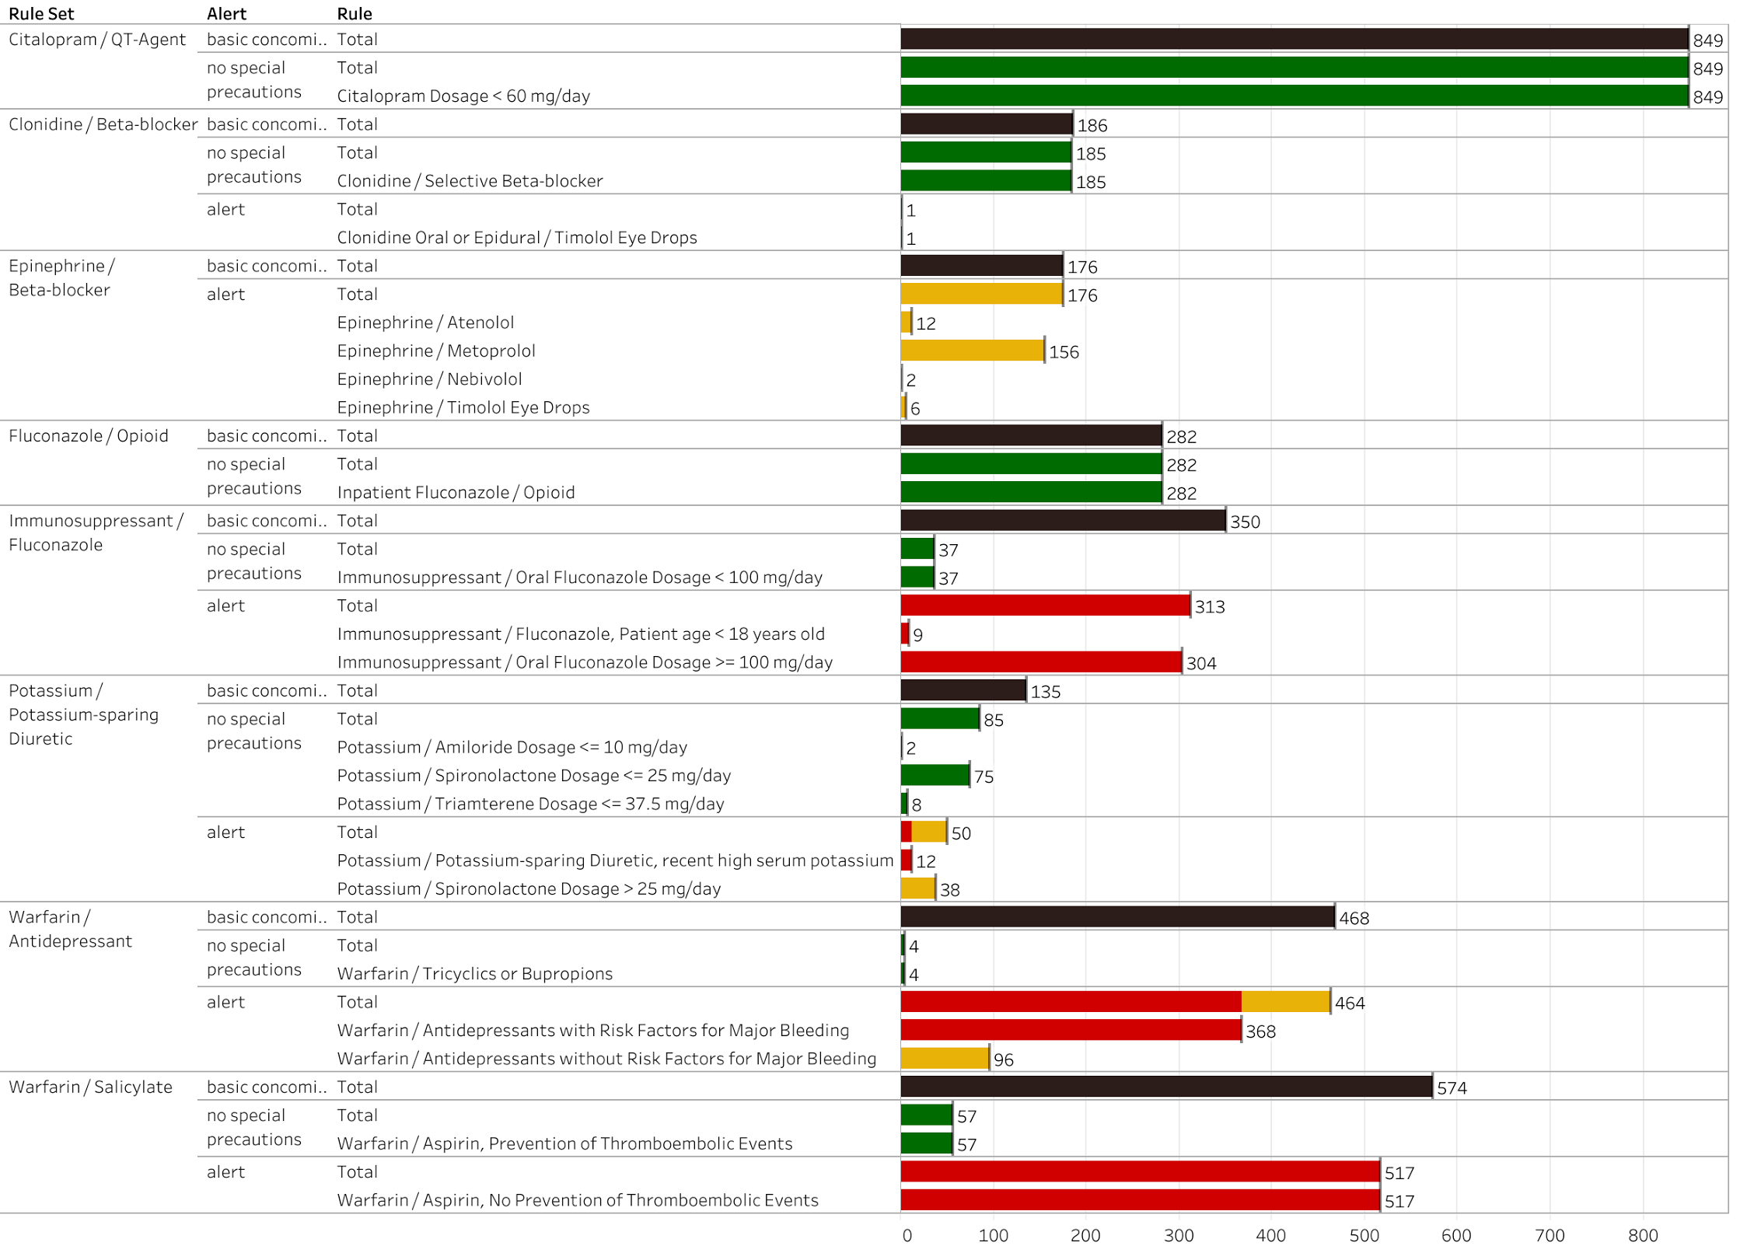
Other contextualization examples
Testing of 8 contextual algorithms on retrospective real-world data showed the potential for to reduce alerts that interrupt clinician workflow by more than 50%.
Chou, E., Boyce, RD., Balkan, B., Rosko, S., Subbian, V., Romero, A., Hansten, P., Horn, J., Gephart, S., Malone, DC., Designing and evaluating contextualized drug–drug interaction algorithms, JAMIA Open, Volume 4, Issue 1, January 2021, ooab023, https://doi.org/10.1093/jamiaopen/ooab023. PMID: 33763631 PMCID: PMC7976224

Slide 14
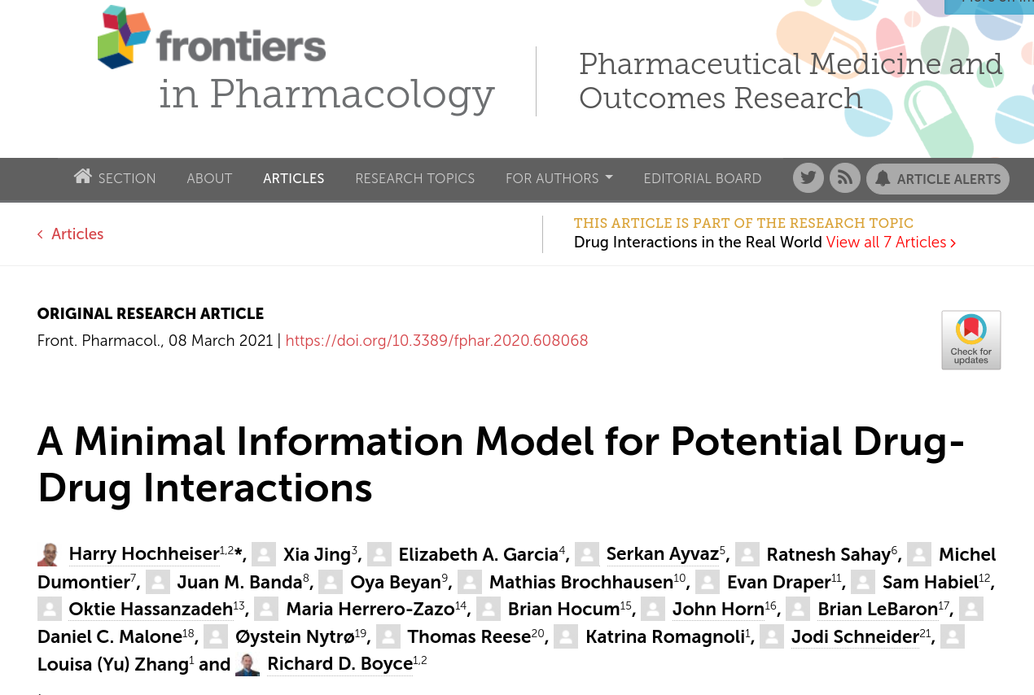
What information is needed to create a contextualized PDDI CDS algorithm?
https://www.frontiersin.org/articles/10.3389/fphar.2020.608068/full

Slide 15
Drugs involved (R1)
Value sets:
RxNorm
ATC
Other
R1 - Explicitly state the drugs involved, ideally using value sets
R2 – Report a mechanism if known (or state “not known”)
Mechanism (R2)
R3 – State the frequency of harm relative to frequency of exposure if known
Frequency of harm vs exposure (R3)

Slide 16
Clinical consequences (R4)
Value sets:
ICD-10-CM
SNOMED-CT
Other
Serious? (R5)
Operational classification statement (R6)
R4 - Explicitly state clinical consequences, ideally using value sets
R5 - Note if a clinical consequence is serious
R6 - Include an operational classification statement
Evidence support

Slide 17
Clinical consequences (R4)
Value sets:
ICD-10-CM
SNOMED-CT
Other
Serious? (R5)
Operational classification statement (R6)
Risk modifying factors or Patient context (R7)
Recommended action (R8)
Evidence support
Evidence support
R7 - State each known risk modifying factor or patient context
R8 - State a recommended action if one is known

Slide 18
Drugs involved (R1)
Value sets:
RxNorm
ATC
Other
MUST report
SHOULD report if known
Mechanism (R2)
MUST report together
Frequency of harm vs exposure (R3)
SHOULD report together if known
Clinical consequences (R4)
Value sets:
ICD-10-CM
SNOMED-CT
Other
Serious? (R5)
Operational classification statement (R6)
Risk modifying factors or Patient context (R7)
Recommended action (R8)
Evidence support
Evidence support

Slide 19
Outline
The role of CDS Hooks

Slide 20
The information model as part of PDDI CDS as a service
An HL7 project within the CDS workgroup
Create an implementation guide that shows how to do PDDI CDS as a service:
The minimum information model, FHIR, CDS Hooks, and CQL
Join us!
https://confluence.hl7.org/display/CDS/PDDI+CDS

Slide 21
Which hooks?
patient-view
Clinician
Shared decision making
order-select, order-sign
Clinician

Slide 22
Patient view
patient-view
Short card summary of PDDIs
Can be actionable from the card
SMART App link
Many PDDI situations require clinician input to arrive at the appropriate action
Shared decision making

Slide 23
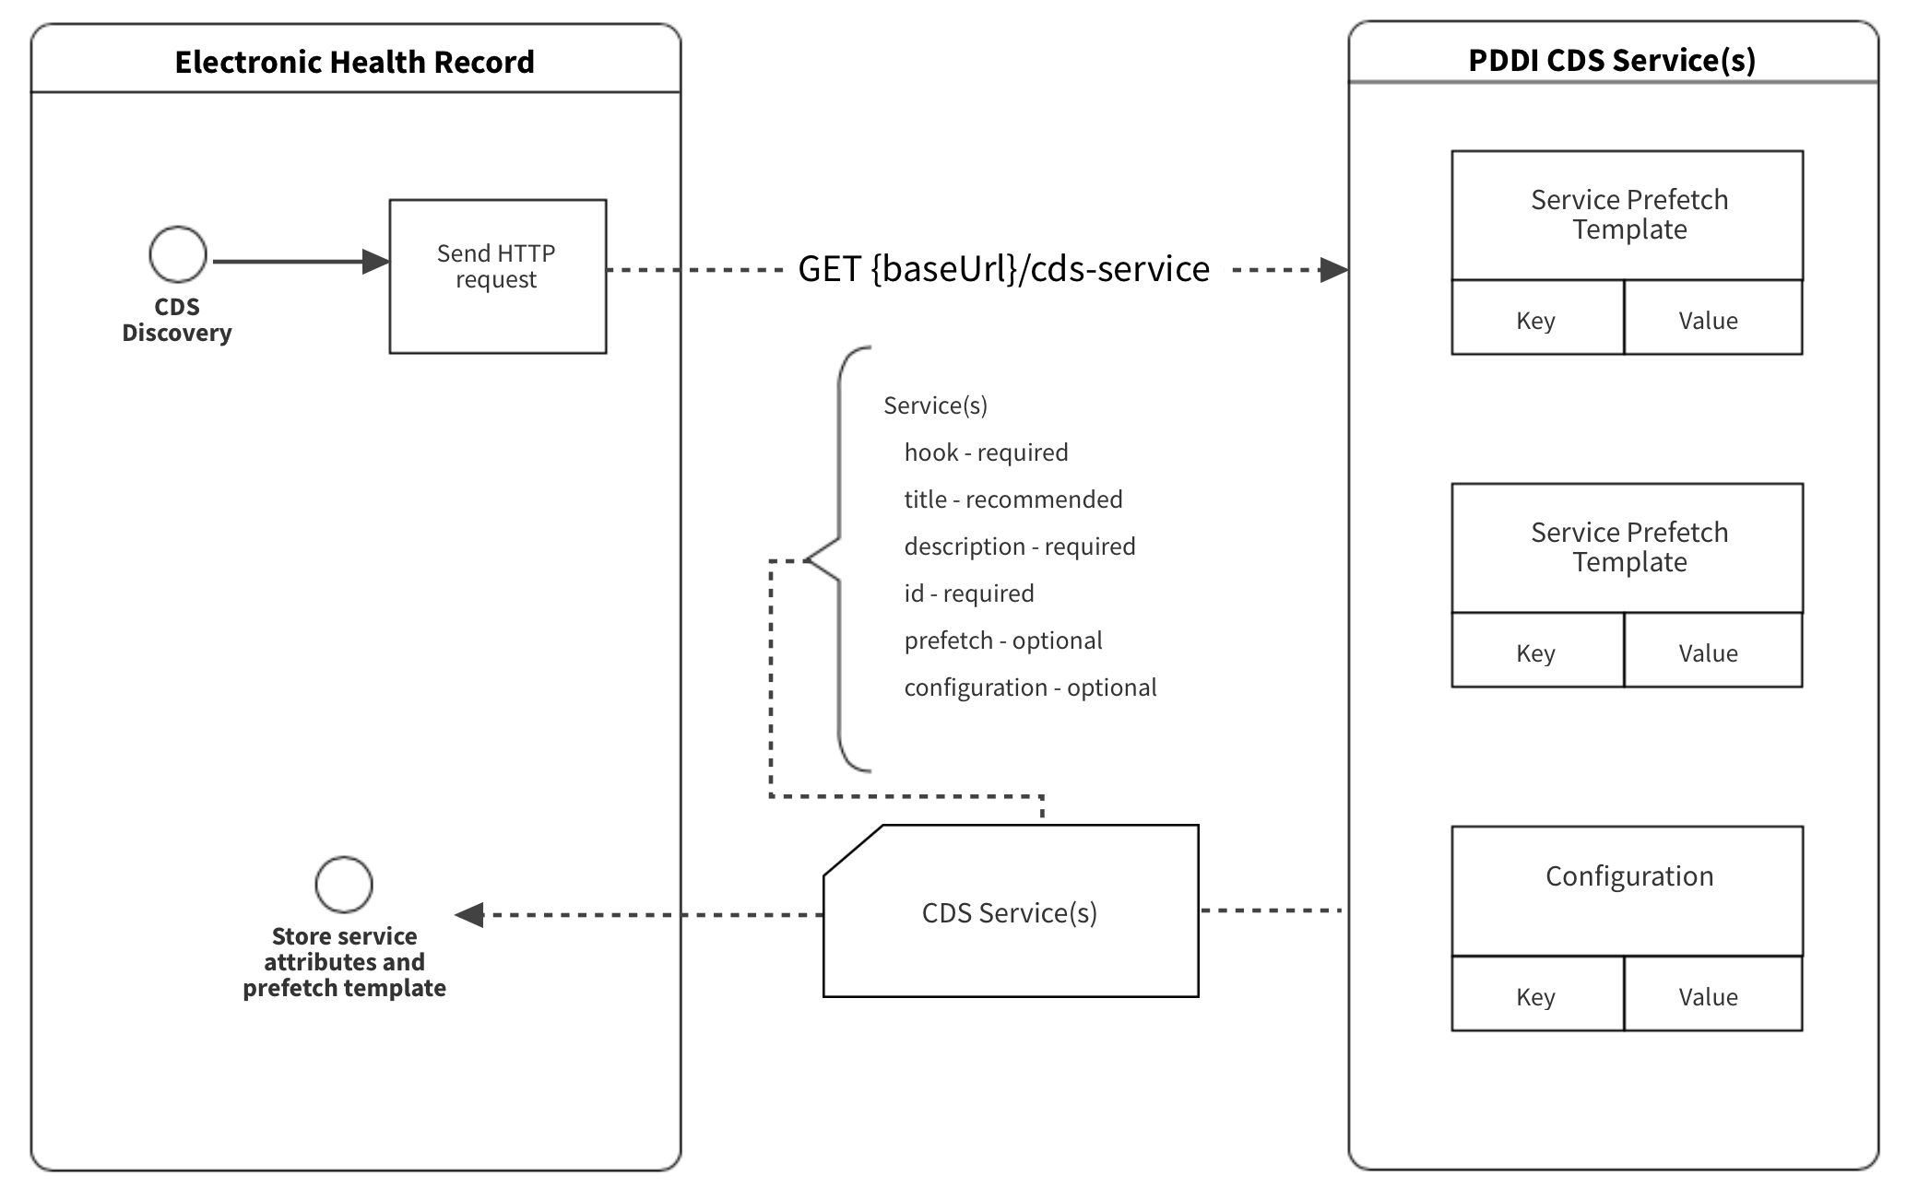

Slide 24
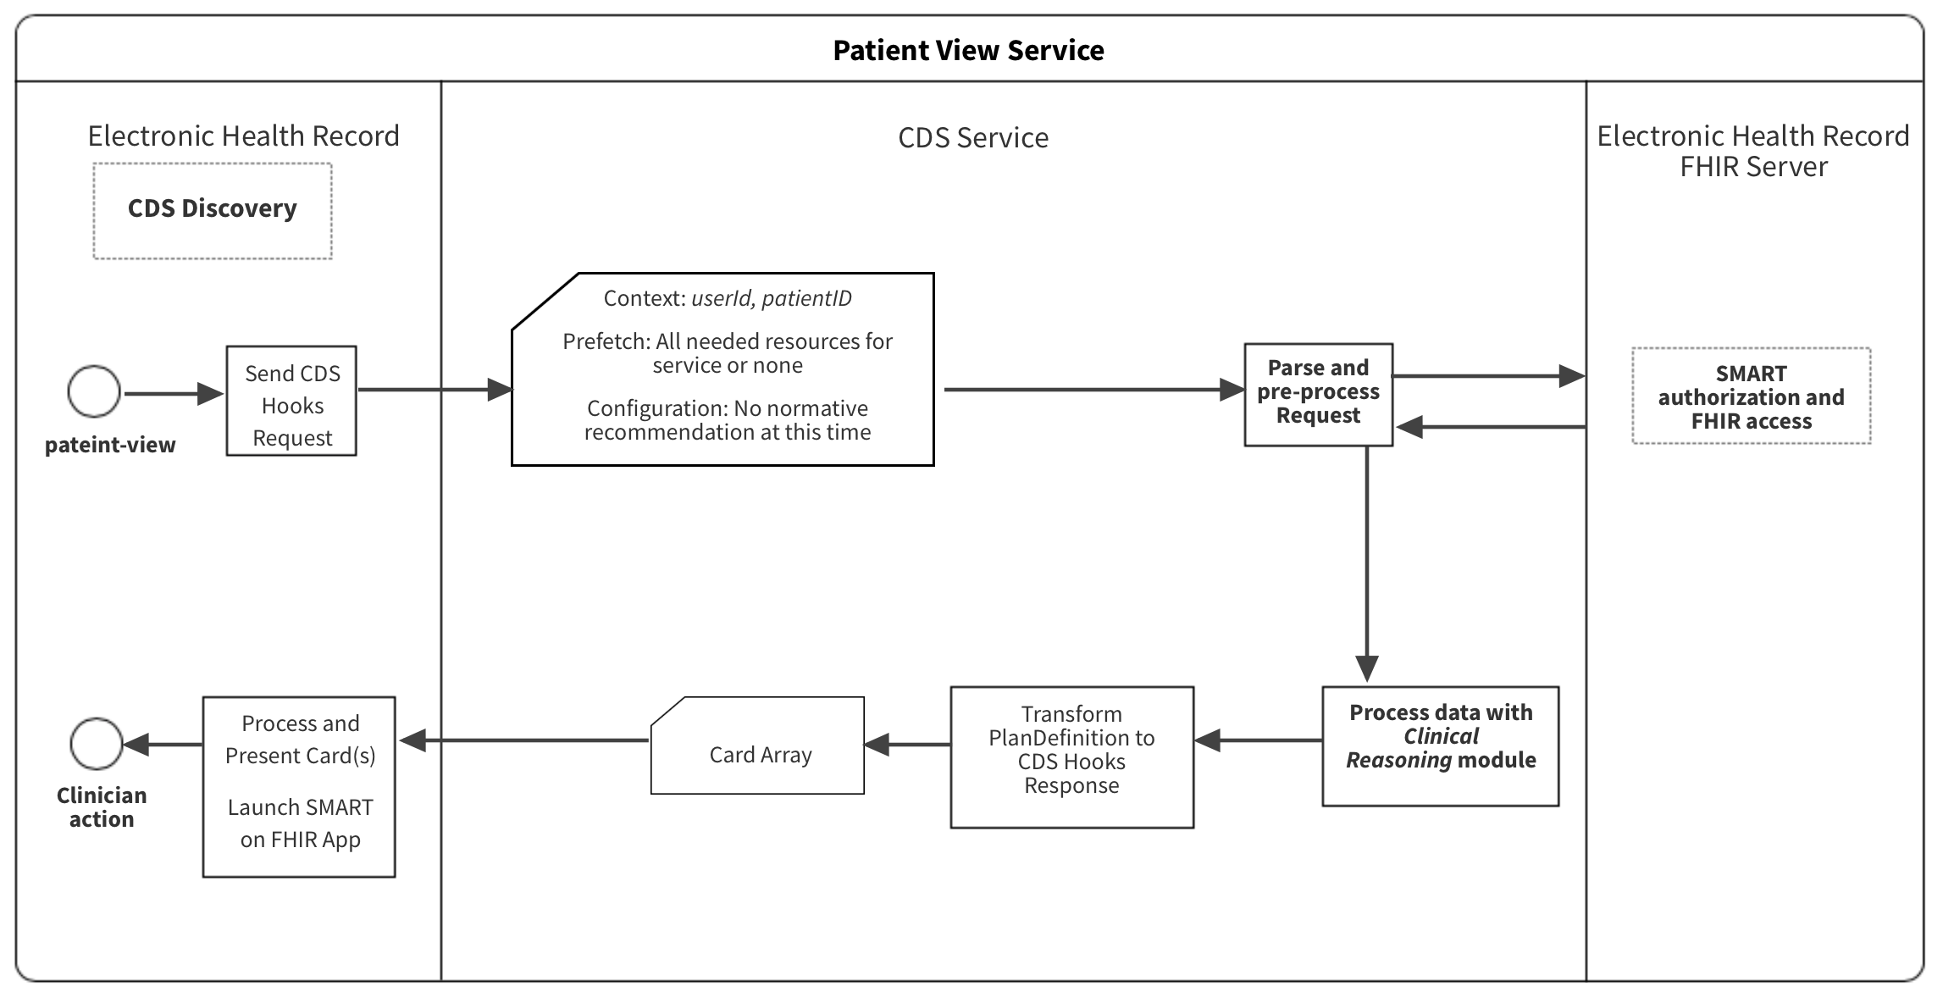

Slide 25
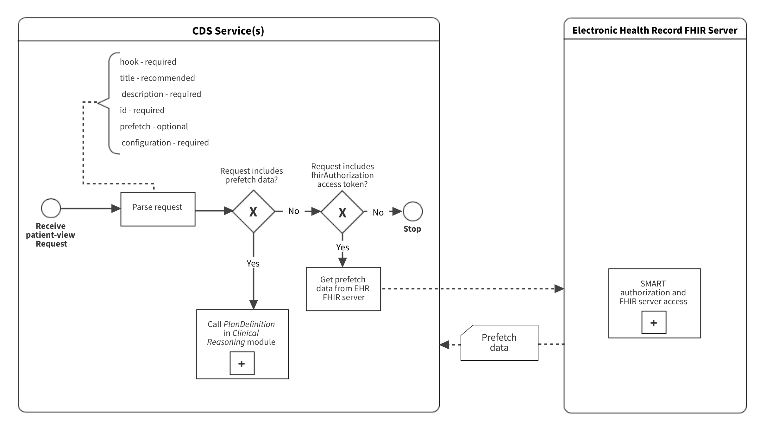

Slide 26
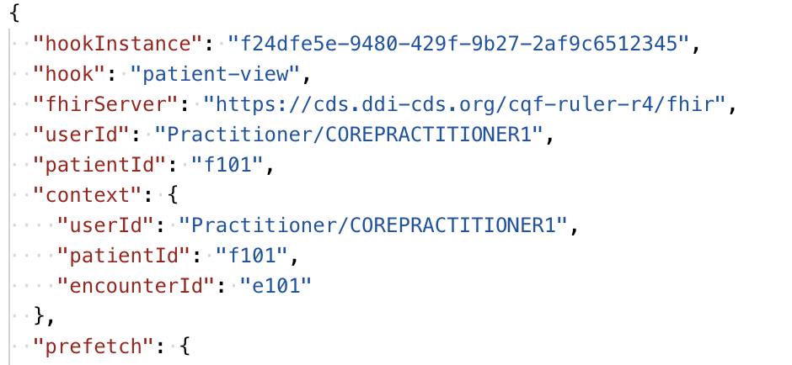
Patient view request

Slide 27
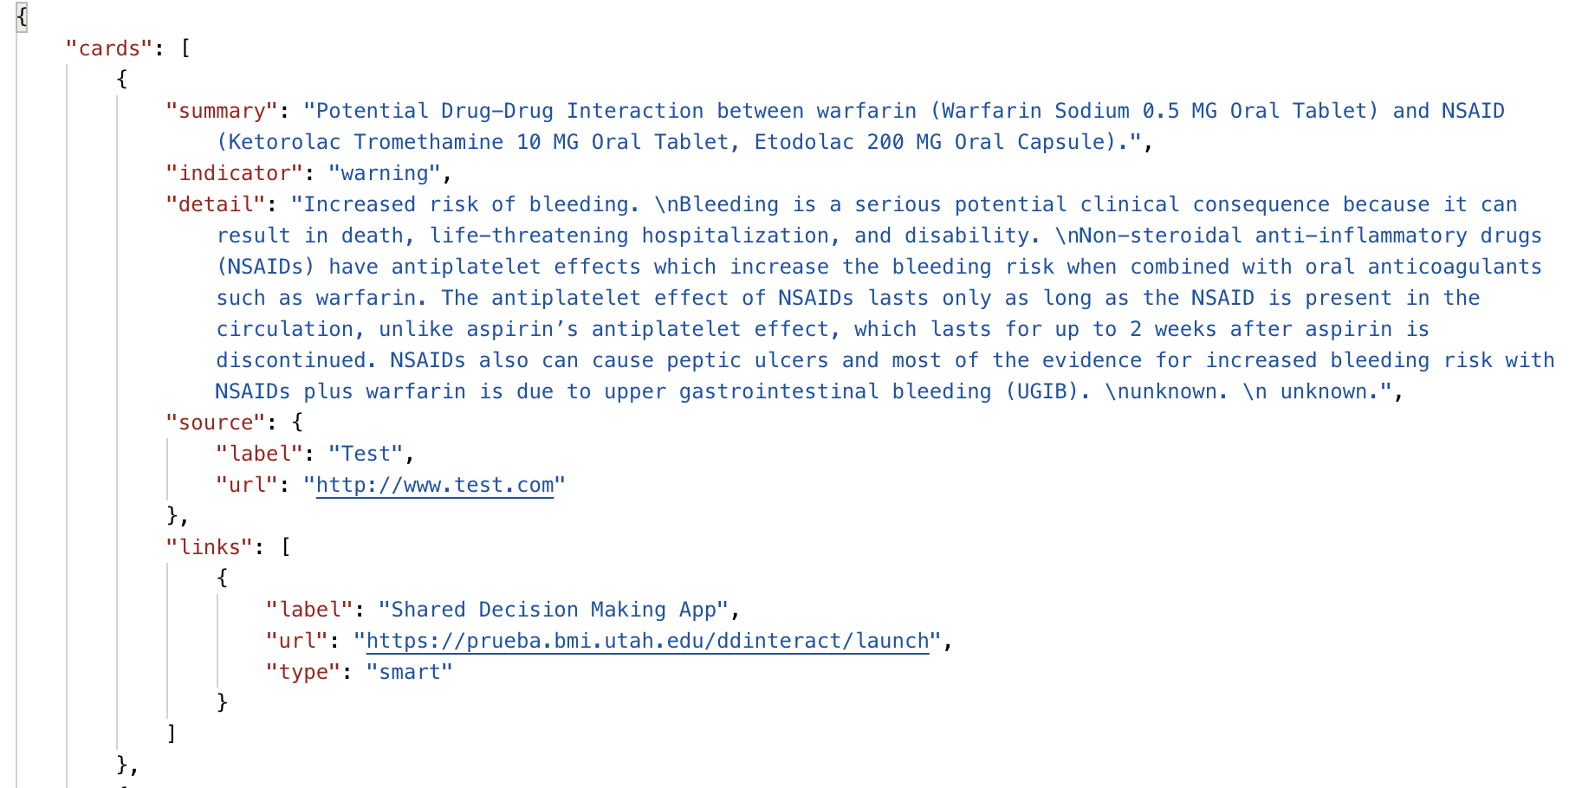
Patient view response

Slide 28
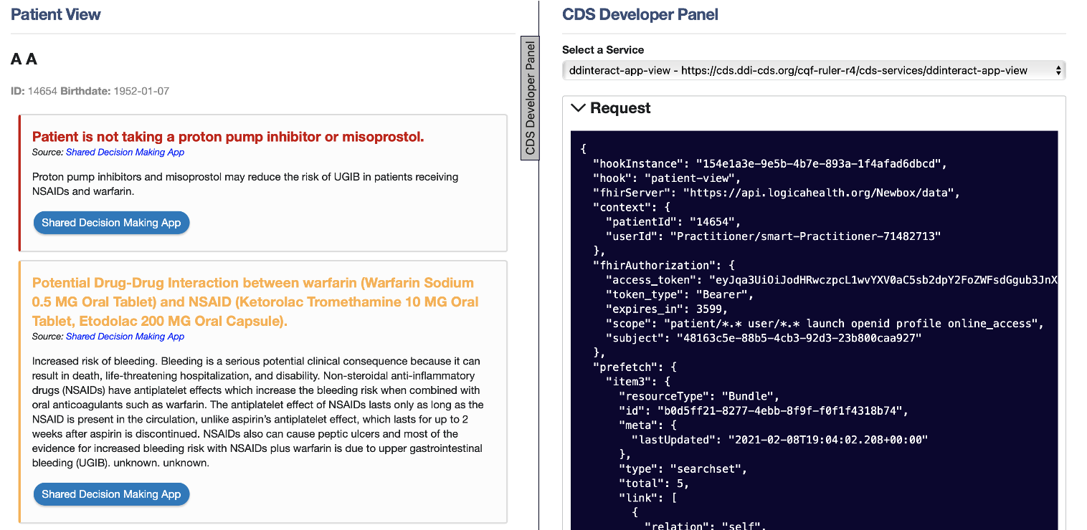
Patient view response – EHR view

Slide 29
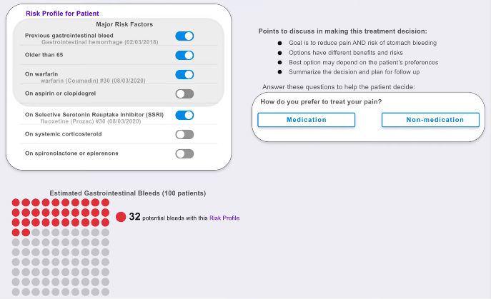
DDInteract© – shared decision making app
U18 HS027099
Try it on Logica or
https://ddi-cds.org/apps#ddinteract

Slide 30
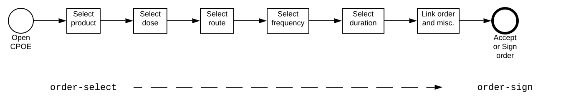
order-select
Clinician-facing CDS
Early in the prescribing workflow
Less cognitive burden than at order-sign?

Slide 31
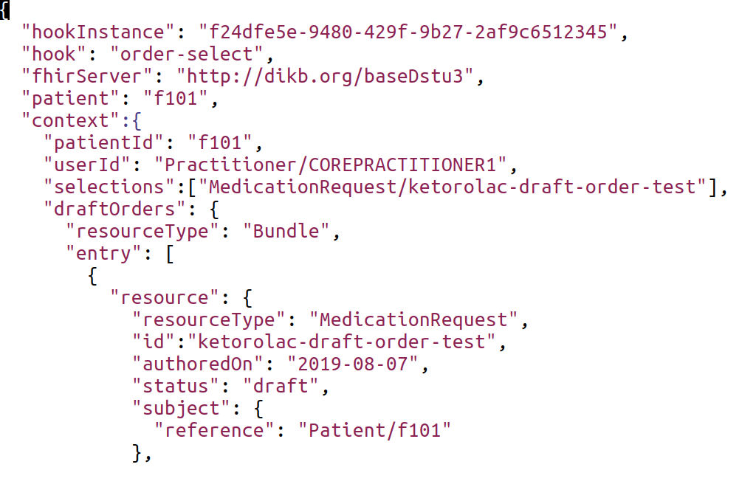
order-select request

Slide 32
order-sign
Clinician-facing CDS
Last step in the prescribing workflow

Slide 33
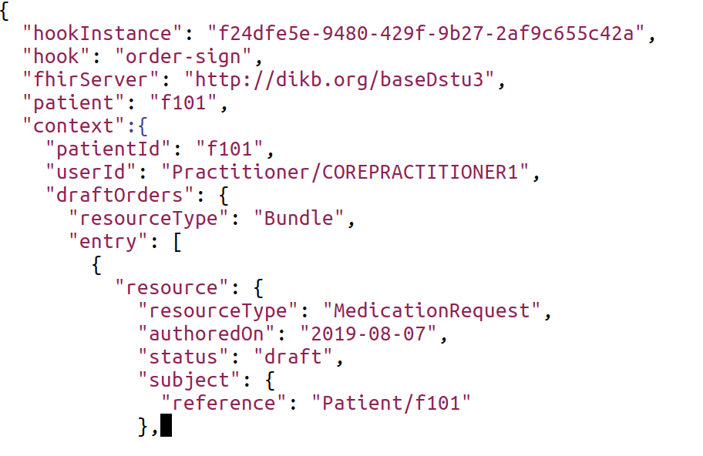
order-sign request

Slide 34
Duplication between order-select and order-sign?
Warfarin - NSAIDs
Warfarin - NSAIDs
Alert!
Alert!

Slide 35
Coordination order-select and order-sign
Maintain some concept of state
Warfarin - NSAIDs
Warfarin - NSAIDs
Info card – alert suppressed
Alert!

Slide 36
Coordination can happen
Requires the service to cache:
Ordering Clinician, Patient, Encounter, Knowledge Artifact URL
Base 64 encoded medication resource specified in selections
An ID created by concatenating the system and code from the “medicationCodeableConcept” of the medication resource (used for retrieving a medication resource during order-sign)
Base 64 encoded summary, detail, and indicator from the CDS cards returned
http://build.fhir.org/ig/HL7/PDDI-CDS/cds-service-spec.html#cds-message-filtering

Slide 37
Should the service filter all alerts automatically?
A CDS service MAY automatically cache order-select data and filter out all related order-sign card-responses
We don’t think this should be the default
The default should be to have the EHR client set configuration options
Ensures that the clinical team that allows the service will have input in specifying its behavior

Slide 38
Configuration Solution
A new structure definition for configuration options (pddi-cds-configuration-options)
Follows the ideas of the DaVinci Coverage Requirements Discovery (CRD)
http://hl7.org/fhir/us/davinci-crd/2018Sep/hooks.html#configuration-options
Example:
https://cds.ddi-cds.org/cqf-ruler-r4/fhir/StructureDefinition/pddi-cds-configuration-options

Slide 39
Configuration Options in PDDI CDS PlanDefinitions
order-select – cache-for-order-sign-filtering
https://cds.ddi-cds.org/cqf-ruler-r4/fhir/PlanDefinition/warfarin-nsaids-cds-select
order-sign – filter-out-repeated-alert
https://cds.ddi-cds.org/cqf-ruler-r4/fhir/PlanDefinition/warfarin-nsaids-cds-sign

Slide 40
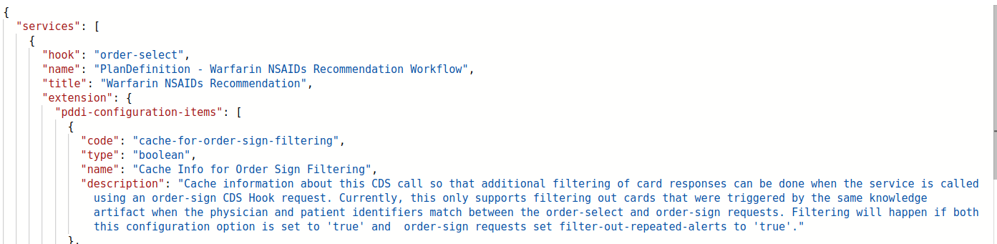
How Configuration Looks in CDS Hooks
GET https://cds.ddi-cds.org/cqf-ruler-r4/cds-services
RESPONSE (order-select service):

Slide 41
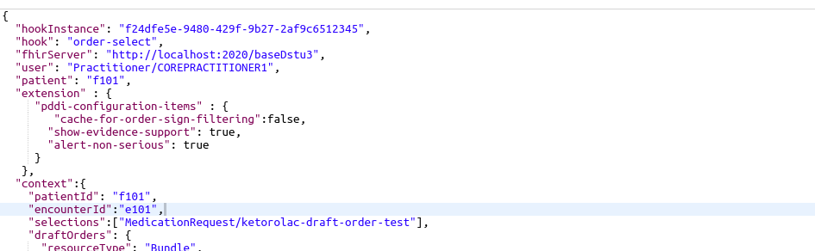
How Configuration Looks in CDS Hooks Continued
POST
REQUEST (Warfarin-NSAIDS order-select service):
https://cds.ddi-cds.org/cqf-ruler-r4/fhir/PlanDefinition/warfarin-nsaids-cds-select

Slide 42
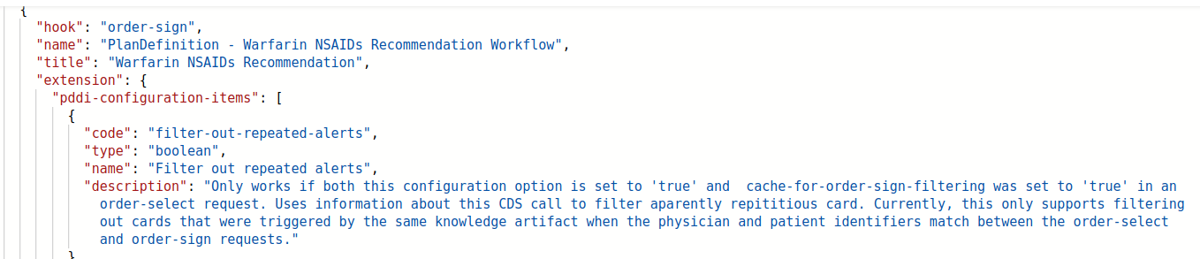
How Configuration Looks in CDS Hooks Continued
GET https://cds.ddi-cds.org/cqf-ruler-r4/cds-services
RESPONSE CONTINUED (order-sign service):

Slide 43
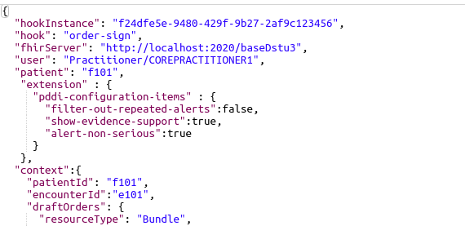
How Configuration Looks in CDS Hooks Continued
POST
REQUEST (Warfarin-NSAIDS order-sign service):
https://cds.ddi-cds.org/cqf-ruler-r4/fhir/PlanDefinition/warfarin-nsaids-cds-sign

Slide 44
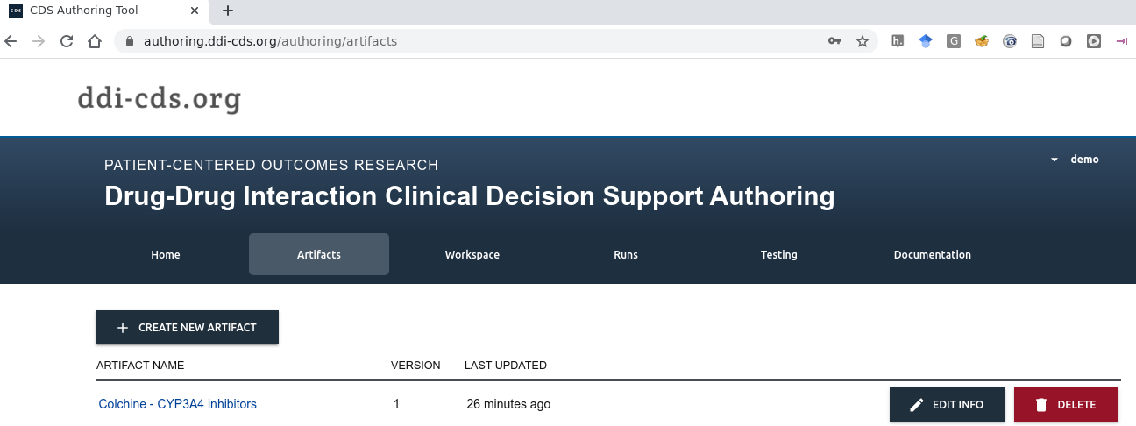
Authoring PDDI CDS rules

Slide 45
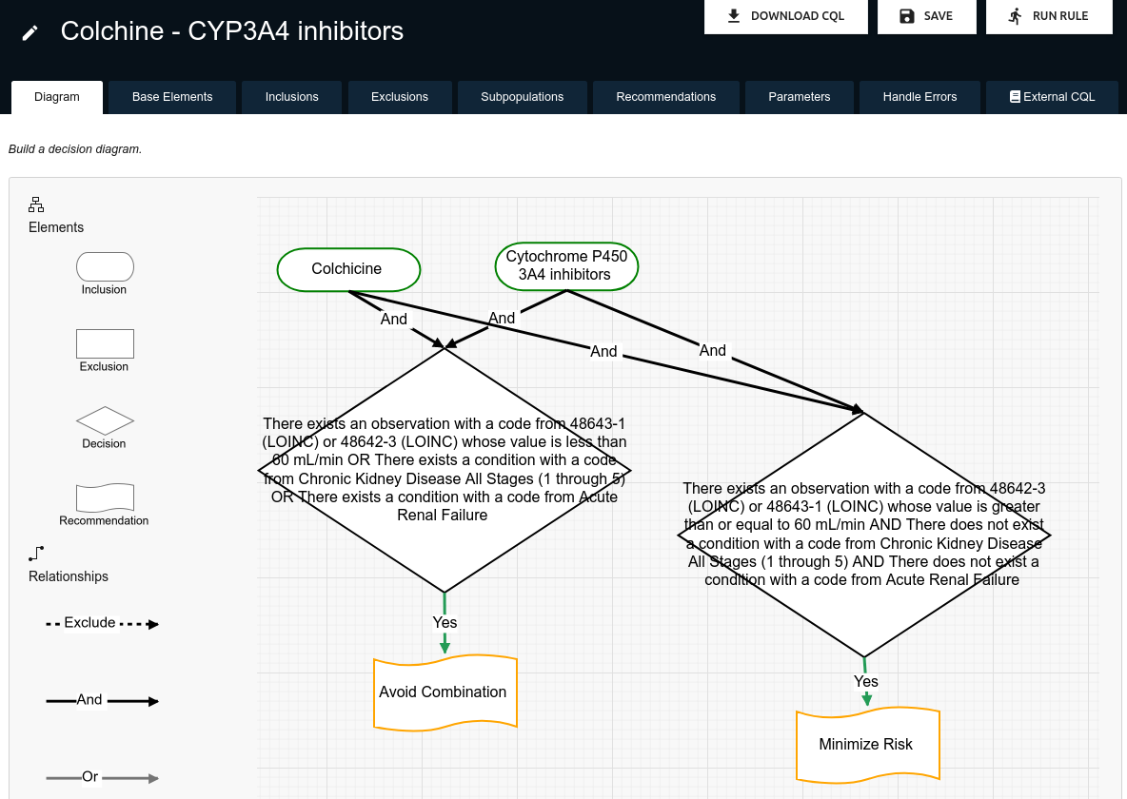

Slide 46
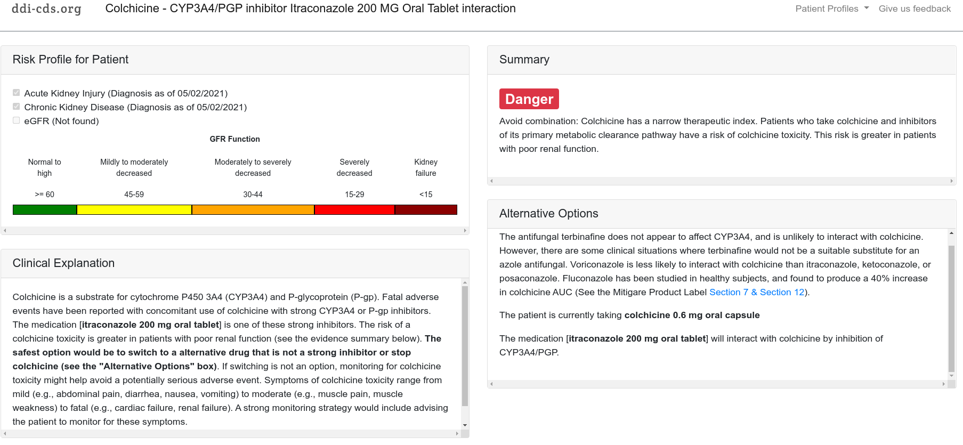
Colchicine – CYP3A4/Pgp inhibitor app
https://ddi-cds.org/apps/#colchicine_cyp3a4

Slide 47
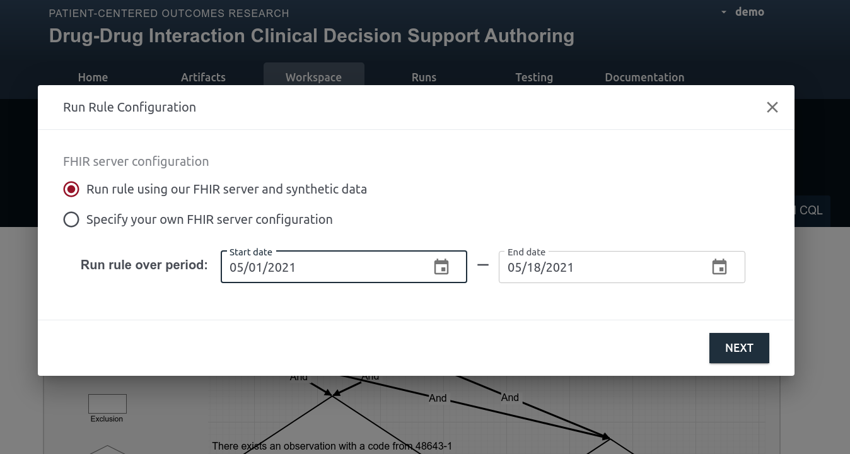
Colchicine – CYP3A4/Pgp inhibitor – rule testing

Slide 48
Summary
The parts of CDS Hooks that the project has been able to successfully use?
Service discovery, patient-view, order-select, order-sign
Extension
Where did we find it necessary to go above and beyond CDS Hooks?
Configuration for coordination between order-select and order-sign
Implementation of app-context on the (service side)
There are PDDI cases where a service cannot suggest an action without clinician input

Slide 49
Summary continued…
Our experience been implementing in production environments?
DDInteract has been implemented in Epic as a SMART on FHIR app (no actual use of CDS Hooks)
Requires re-implementation of the PDDI CDS logic
What should implementers be aware of?
We are still in the early stages of translation
Positive/negative of an increased use of CDS Hooks?
Positive: reduced barrier to adoption of contextualized algorithms
Negative: authoring and testing might be more challenging

Slide 50
Discussion

Slide 51
Acknowledgements
U18 HS027099, R01HS025984 and R21HS023826 from the Agency for Healthcare Research and Quality
R01LM011838 and T15LM007059 from the National Library of Medicine
Dr. Daniel Malone, Dr. Philip Hansten, Dr. John Horn, Max Sibilla and many others.
The HL7 CDS Workgroup, and the W3C Semantic Web in Health Care and Life Sciences Community Group

Slide 52
Discussion

